Slide 1
Business Proposal
Representer – CEO
Company name - Balleaqua
Sukhjeet Singh (301126283)

Slide 2
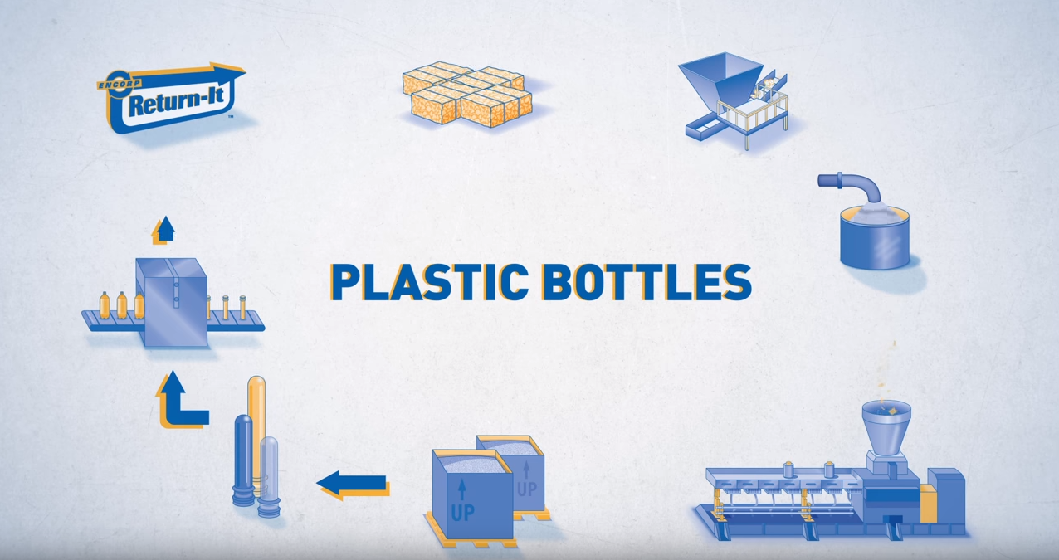
Introduction
Establishing new plastic recycling plant and introducing new return policy for company’s products.
Figure 1.1
Why it is important for our business ?
Source -(Munroe, 2020)
Notes:
As a CEO of Belleaqua and I pleased to submit the proposal on the potential benefits that the company will get through the establishing of plastic recycling plant launch of a new bottle return policy. This policy is vital to maintain the sustainability of the business because recent negative publicities can dramatically affect the bottled water industry.

Slide 3
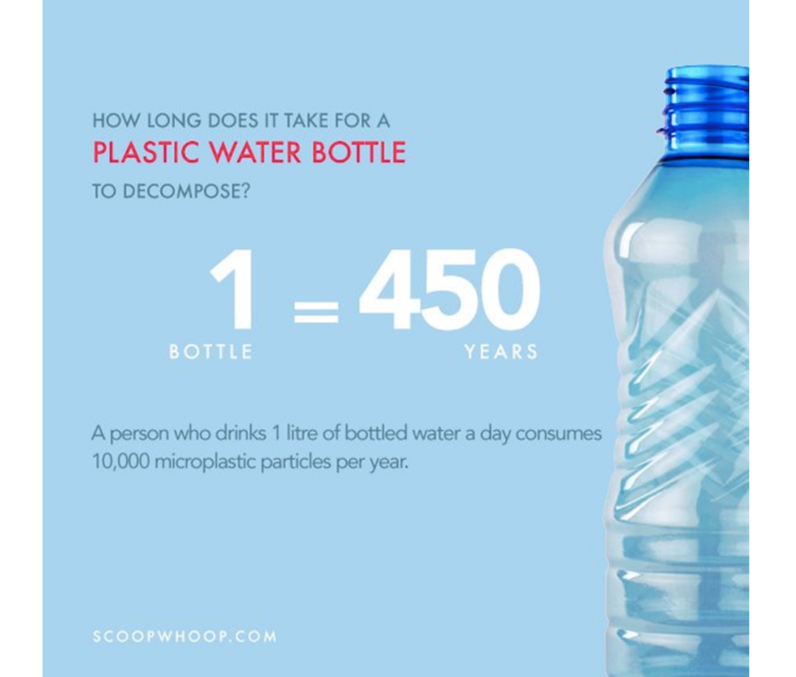
Understanding the Problem
From 6 bottles only One recycled.
Decomposition is Photo degrade (Riverkeeper, 2019).
.
Figure 1.2
Environmental and Economic Concerns
Government laws to restrict the purchase of bottled water. (Riverkeeper, 2019).
Political Concerns
Image source- (Allen, 2020)
Notes:
Understanding the problem
There are major problem associated with plastic bottle usage that can dramatically affect the bottled water industry.
Environmental and Economic Concerns-
It is pretty bad to see that for every six bottles people buy, only one is recycled. As a result, overflowing of discarded water bottles and most of them end up in landfills. That leads to a big problem because the water bottles are not biodegrade, but rather are photo degrade. The fact is that it takes at least 450 years for every single bottle to decompose, leaking pollutants into our soil and water along the way as it decomposes
Political Concerns
Many local bodies have passed laws to restrict the purchase of any bottled water. For example New York City, have passed laws to restrict the purchase of any bottled water with government funds in efforts to save the environment. (Riverkeeper, 2019)

Slide 4
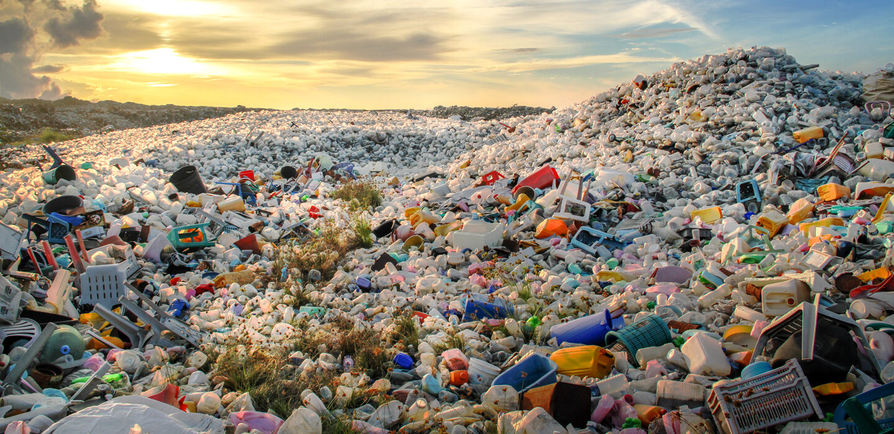
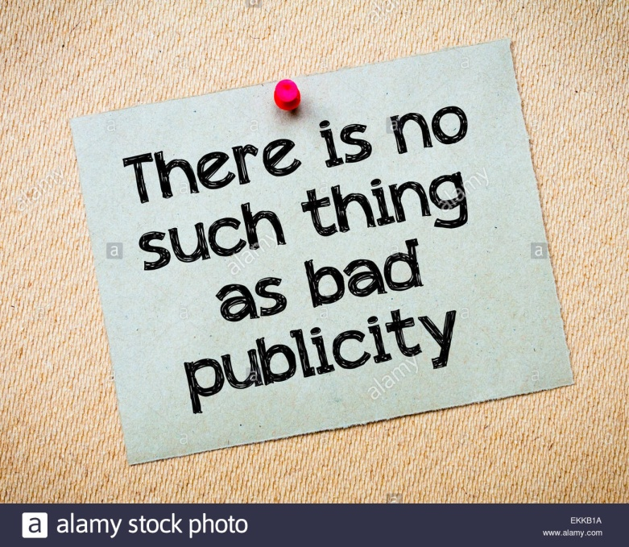
Understanding the Problem continue..
Figure 1.3
Decrease the company's revenue
Harm brand image
Negative publicity
Source-(Pringle & George, 2018)
Notes:
Negative publicity
The negative publicity from last few years of the bottled water industry and repercussion of plastic bottle can decrease the company's revenue and can also damage the brand image, thus it can dramatically affect the sustainability of our business.
Figure display land filling site of plastic bottles.

Slide 5
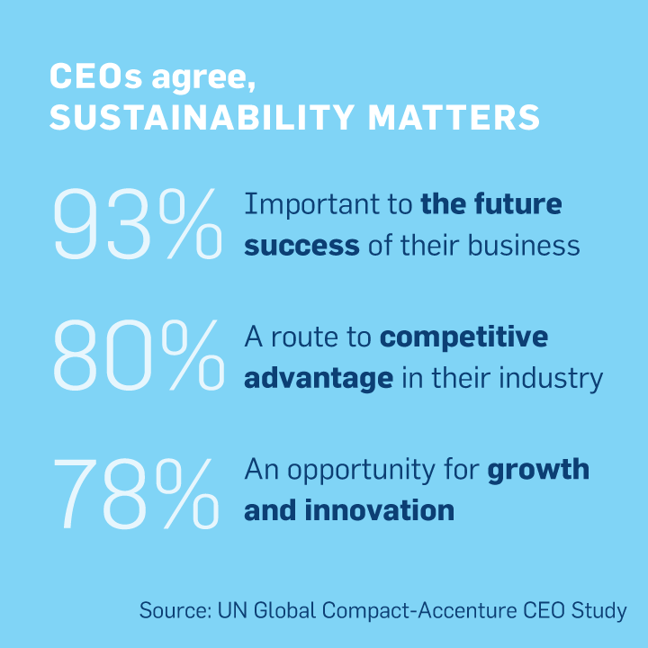
Solution
Establishing a new Recycling plant
Introduce Bottle Return Policy
Benefits of Establishing a new Recycling plant
First-mover Advantage
Leader in sustainability
Improve company image, reputation and increase market share.
Figure 1.4
Notes:
Solution –
Establishing a new Recycling plant in company is best solution to tackle with these major issues and also to maintain the sustainability of the
business. Moreover, through this recycling plant we can introduce the new Bottle Return Policy .Although this proposed solution may be entirely different and new in this business but it would be beneficial for future perspectives
Benefits
Benefits
First-mover Advantage
The launch of such a policy will make us a leader in environmental sustainability and can improve company image, reputation and increase market share.

Slide 6
Benefits to Business
.
Higher Quality Recruits
Save Money
.
Make Money
Notes:
Benefits to Business
Make Money – Making sustainable choices and implement recycling programs can allow selling waste for alternative uses thus earning back money. (Cleanriver, 2019)
Attract Higher Quality Recruits and Improve Employee Retention -Employees are more motivated to work for a company that works sustainably. (Cleanriver, 2019)
Save Money - Plastic water bottles are made from a petroleum product called polyethylene terephthalate (PET), which requires giant amounts of fossil fuels to make and transport. (Cleanriver, 2019)

Slide 7
Benefits to Business Continue..
Green Customers
Source - (Townsend, 2018)
Notes:
Green Customers- Policy can attract eco-friendly buyers and increase revenue. According to Townsend survey, It was found that 88% of consumers feel motivated to help to those organization who want to make a difference. Thus, it pose a big opportunity to work in sustainable manner which intrinsically generate revenue for company.

Slide 8
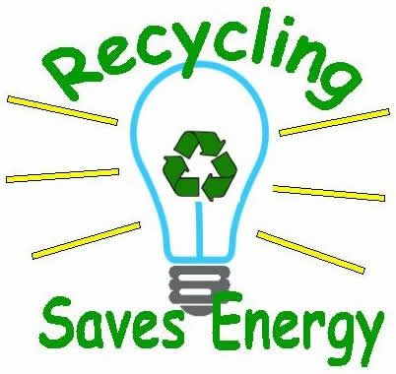
Benefits Continue…
Figure 1.5
Protect environment:
Saves Energy
Diverts More Waste from landfill
Prevents Global warming
Source -(Save Energy 4U, n.d.)
Notes:
Protect environment
Saves Energy- It takes less energy to reuse and recycle material than it does to produce the same material from scratch. (Cleanriver, 2019)
Diverts More Waste from Landfill- would greatly reduce the amount of plastic currently finding its way to landfills and into the oceans. (Cleanriver, 2019)
Prevents Global warming- The plastic bottle releases the toxic chemicals into our soil and water along the way as it decomposes, thus recycling plant can greatly reduces the ever-growing problem of global warming.

Slide 9
Budget
15 million dollars.
Decreases the corporate and shareholder earnings.
PLANET
PEOPLE
PROSPERITY
Notes:
A 15 million dollars investment is required in developing and launching this program. Although it is a huge cost and significantly decreases the corporate and shareholder earnings for the current period, I believe that this policy will be advantageous to our business for the longer term after considering its benefits.

Slide 10
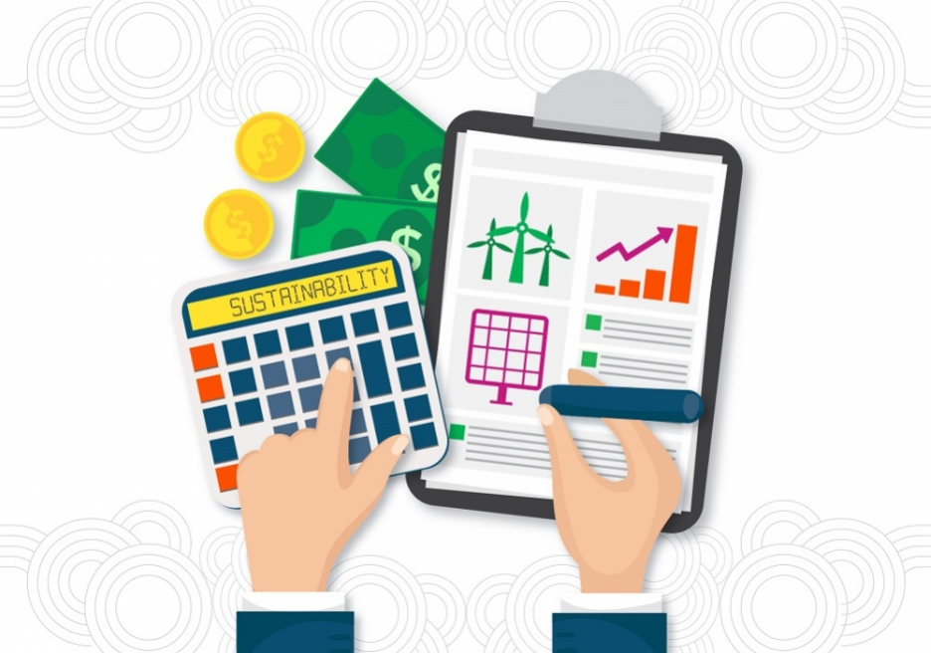
Conclusion
Figure 1.6
Environmental concerns can affect the future sustainability of our business. However, recycle plant can improve image, indeed generate profits.
Source-(IDB invest, n.d.)
Notes:
The environmental concerns associated with the usage of plastic bottles can affect the future sustainability of our business. However, the launch of this program allows us to improve the company image, indeed generate profits. Even though it is a new concept in this field I believe it will able to stand strongly and make our company best and strongest than ever in this industry.

Slide 11
REFERENCES
Allen, C. (2020, December 22). How long does it take plastic to decompose – longer than you think. Consumer Data Marketplace. https://getcaddle.com/blog/how-long-does-it-take-plastic-to-decompose-longer-than-you-think/
Townsend, S. (2018, November 21). 88% Of Consumers Want You To Help Them Make A Difference. Forbes. https://www.forbes.com/sites/solitairetownsend/2018/11/21/consumers-want-you-to-help-them-make-a-difference/?sh=775859976954
Cleanriver. (2019, January 7). Why Is Recycling Important For A Business? 5 Surprising Benefits. https://cleanriver.com/blog-why-recycling-important-for-business/
Riverkeeper. (2019, February 7). Problems with bottled water. https://www.riverkeeper.org/campaigns/tapwater/bottled-water/
Munroe, J. (2020, November 13). Encorp and The Plastic Bottle Recycling Process. Willowbrook Recycling Langley BC. https://willowbrookrecycling.com/encorp-and-the-plastic-bottle-recycling-process/
United Nation Global Compact. (n.d.). How Will I Benefit? | UN Global Compact. Unglobalcompact. https://www.unglobalcompact.org/participation/join/benefits
Save Energy 4U. (n.d.). Pinterest. Retrieved March 21, 2021, from https://in.pinterest.com/pin/735142339159661784/
IDB invest. (n.d.). Sustainability makes business sense | IDB Invest. Idbinvest. https://idbinvest.org/en/blog/climate-change/sustainability-makes-business-sense
Pringle, J., & George, S. (2018, August 29). Why we’re hunting for treasure – in old landfill sites. The Conversation. https://theconversation.com/why-were-hunting-for-treasure-in-old-landfill-sites-102304

Slide 12
If you have any questions, please feel free to ask
THANK YOU

